Slide 1
Extracting damping from ambient vibration

Slide 2
Overview
Apply bandpass filter to measured acceleration time trace
Double integrate acceleration signal to obtain displacement
Reconstruct free decay signal from random vibration
Determine damping from free decay signal

Slide 3
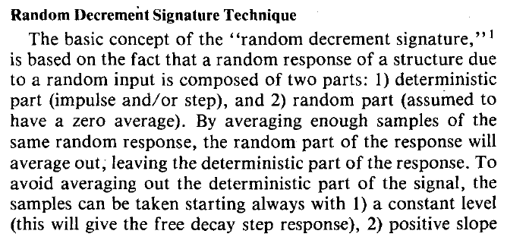
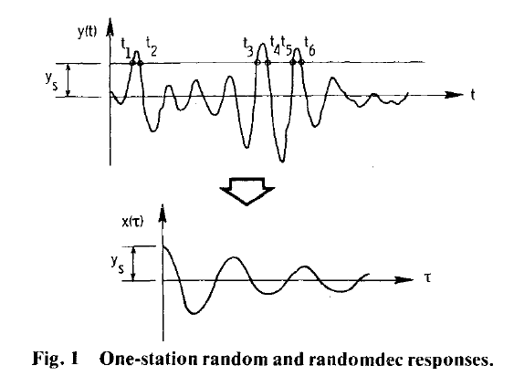
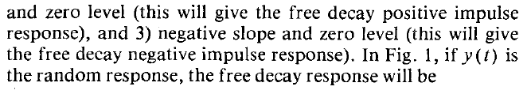

Random Decrement Technique
Impulse part
Random part
( assumed zero mean)
Requires :
ys = triggering value
Ts = segment length ( how long decay will last)

Slide 4
Define the segment heads
Ts

Slide 5
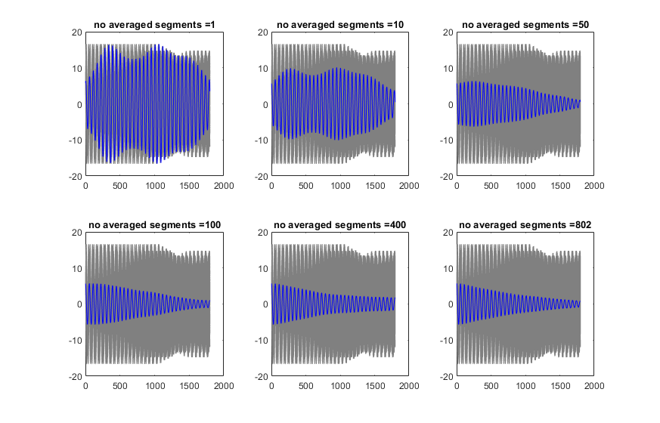
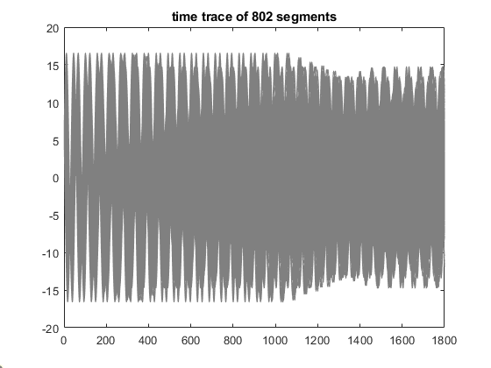
Removing random component

Slide 6
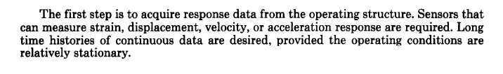
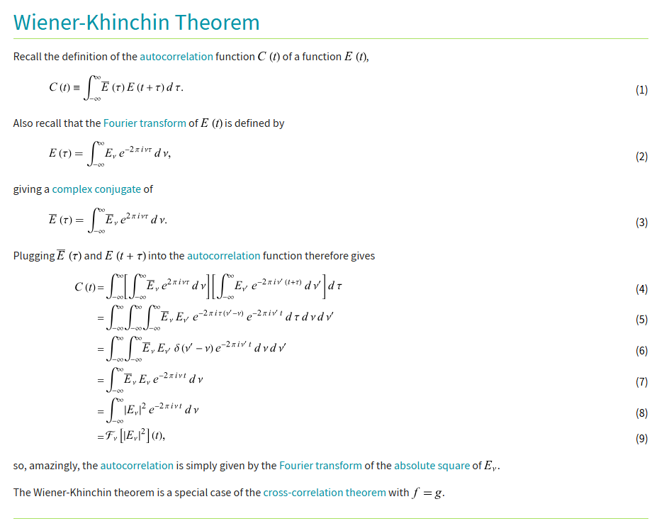
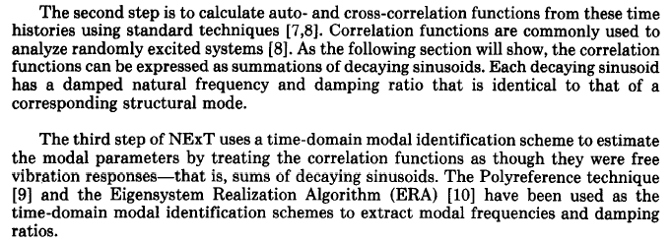
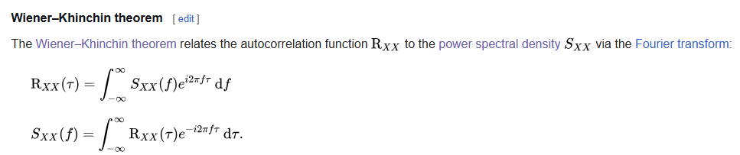
The Natural Excitation Technique (NExt)
“xcorr” matlab command to obtain auto- or cross correlation function
Requires :
Ts = segment length ( how long decay will last)

Slide 8
December 2024

Slide 9
Jan 2025

Slide 10
Feb 2025

Slide 11
March 2025

